Slide 1
2015-2016 Chicago Chapter
  Jack Black Chapter Chair
  Roger Swanberg Vice Chair
  Tom Braxton Program Chair
  Frank Krozel Webmaster and Mini Symposium Chair
  Bob Hofmann Treasurer and Scholarship Chair
  Jerry Meyerhoff Secretary and Education Chair
  Ray Klouda Membership Chair
  Craig Fanning Publicity
  Dennis Barfuss Co Secretary
  Roy Leventhal Section Coordinator and Representative
  Louann Devine Emeritus Education Chair
  Steve Crifase Student Activities Chair-(graduated)

Slide 2
2015-2016 Chicago Chapter
  6 Chapter Meeting- Three Joint Meetings
  19th Annual EMC Mini Symposium
  Holiday Party
  Awards Banquet
  Engineering Week Illinois Institute of Technology
  IEEE EMC Society Chicago Chapter Scholarship Award
  IEEE Chicago Section Region 4 Technical Symposium

Slide 3
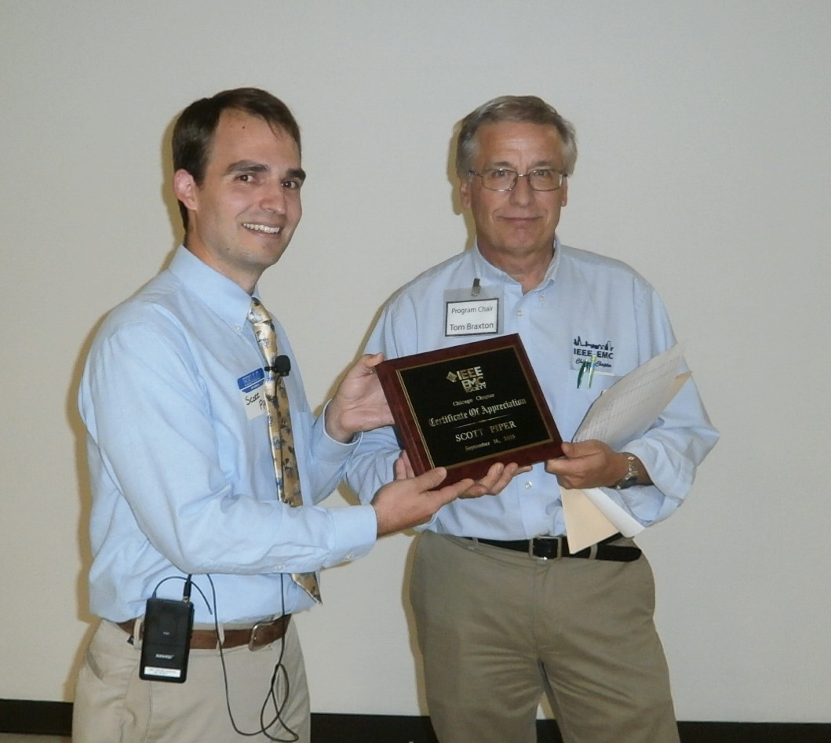
September Chapter Meeting
Scott Piper General Motors
3 EMC Demonstrations

Slide 4
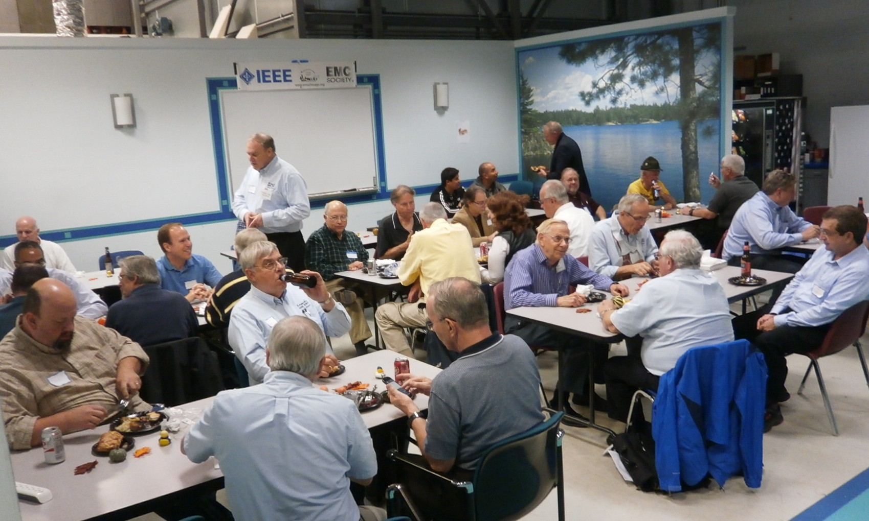
2016 Annual Oktoberfest
Elite Electronic Engineering

Slide 5
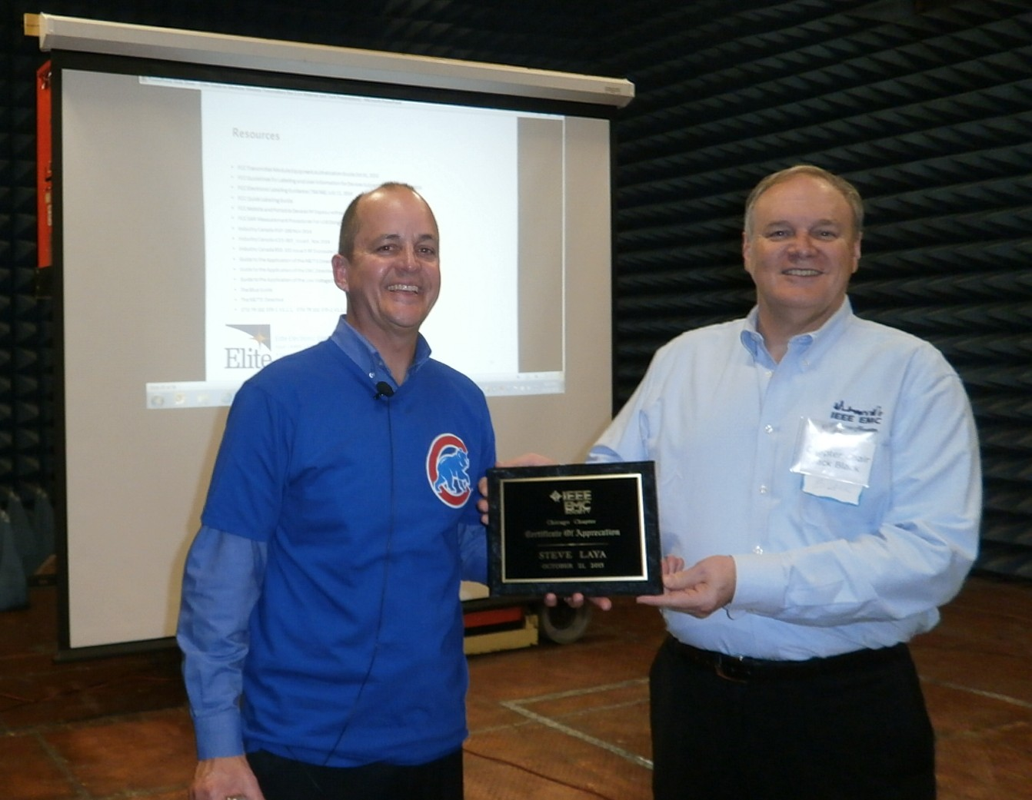
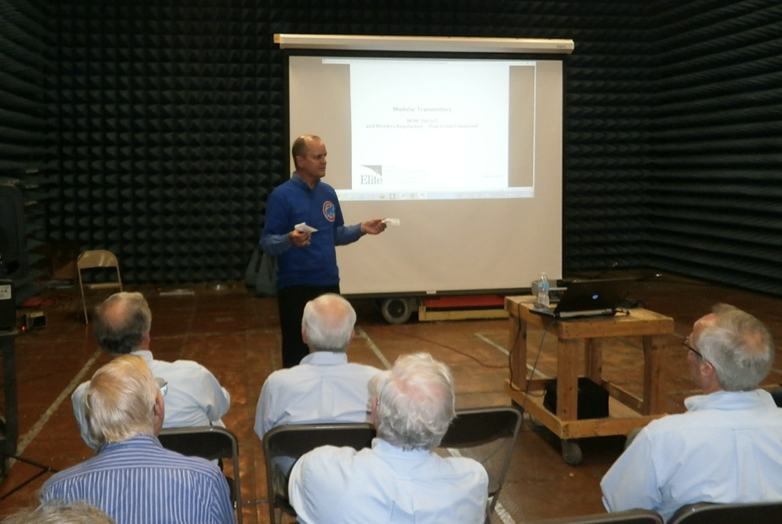
October Chapter Meeting
Steve Laya Elite Electronics
Wireless Module Compliance Process

Slide 6
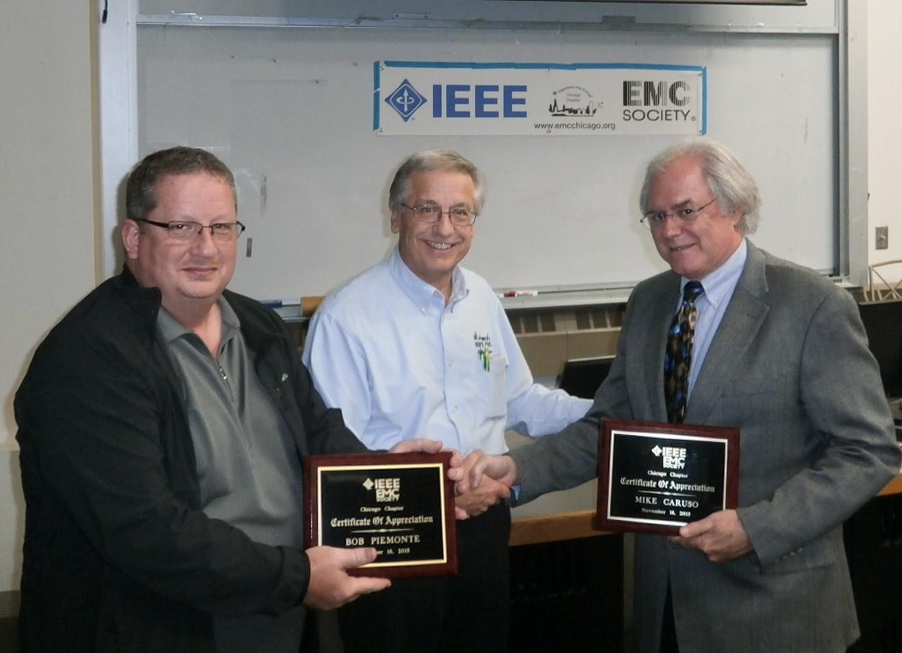
November Chapter Meeting
Bob Piemonte and Mike Caruso ETS
EMP Compliance

Slide 7
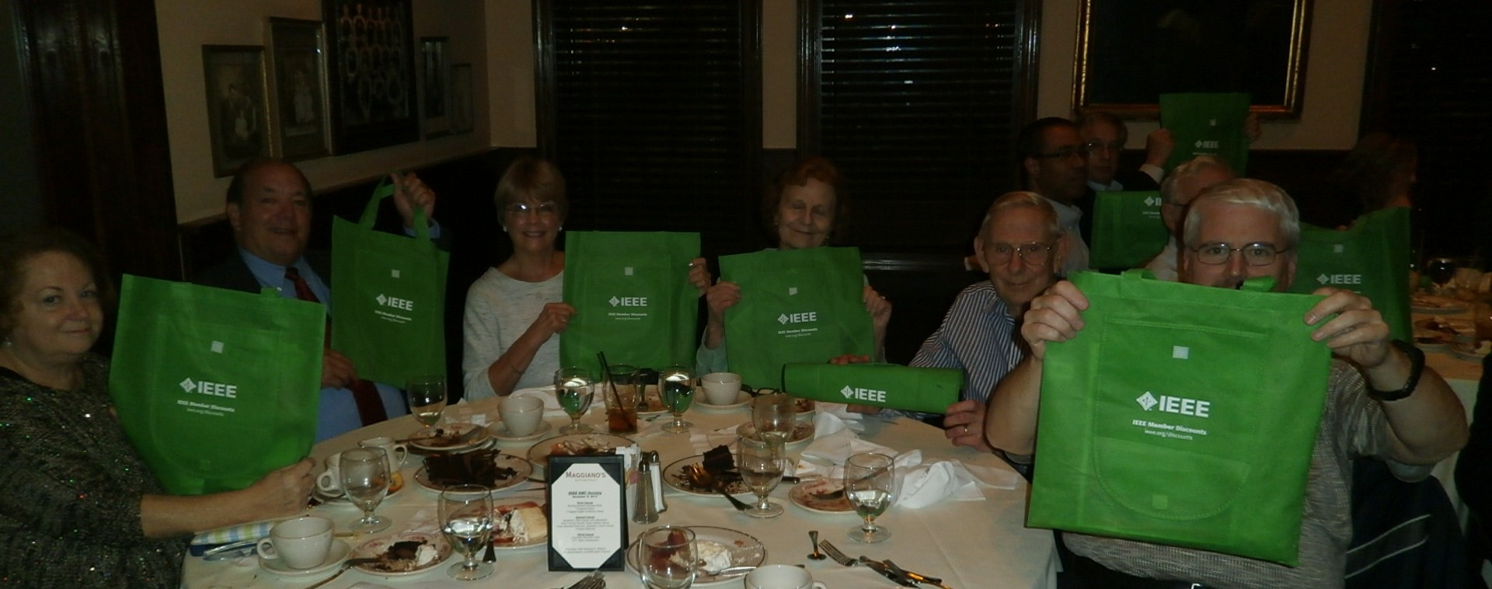
December 2015 IEEE EMC Society Holiday Party

Slide 8
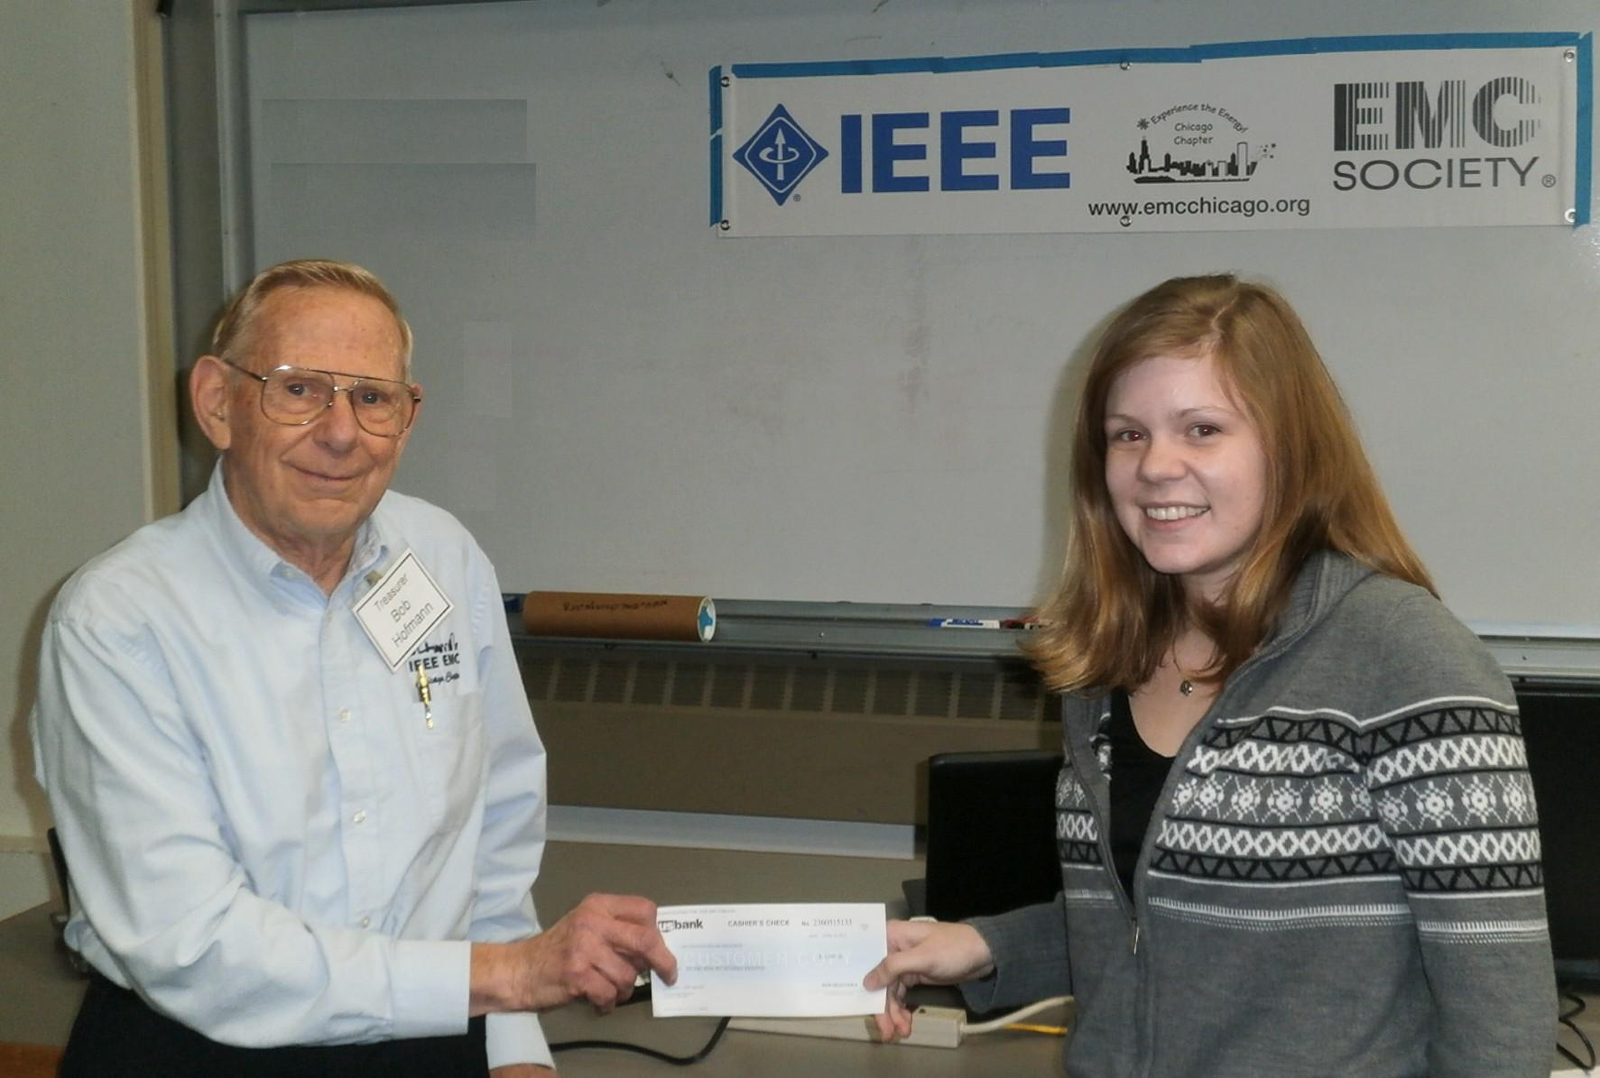
2015 Scholarship Award Winner
Allissa Bowes

Slide 9
February 2016 Engineers Week

Slide 10
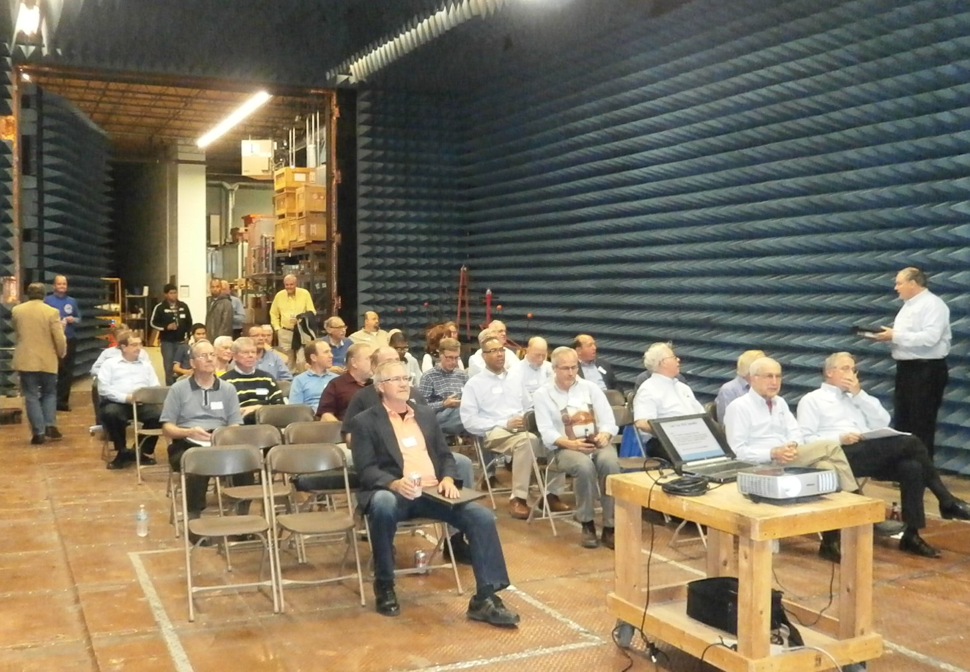
March Chapter Meeting
Annual St. Patrick's Day Feast
Elite Electronics Engineering

Slide 11
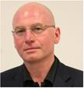
March Chapter Meeting
Dr. Bogdan Adamcyzk
Grand Valley State University
EMC Crosstalk between PCB Traces and
“Young Engineers in Training”

Slide 12
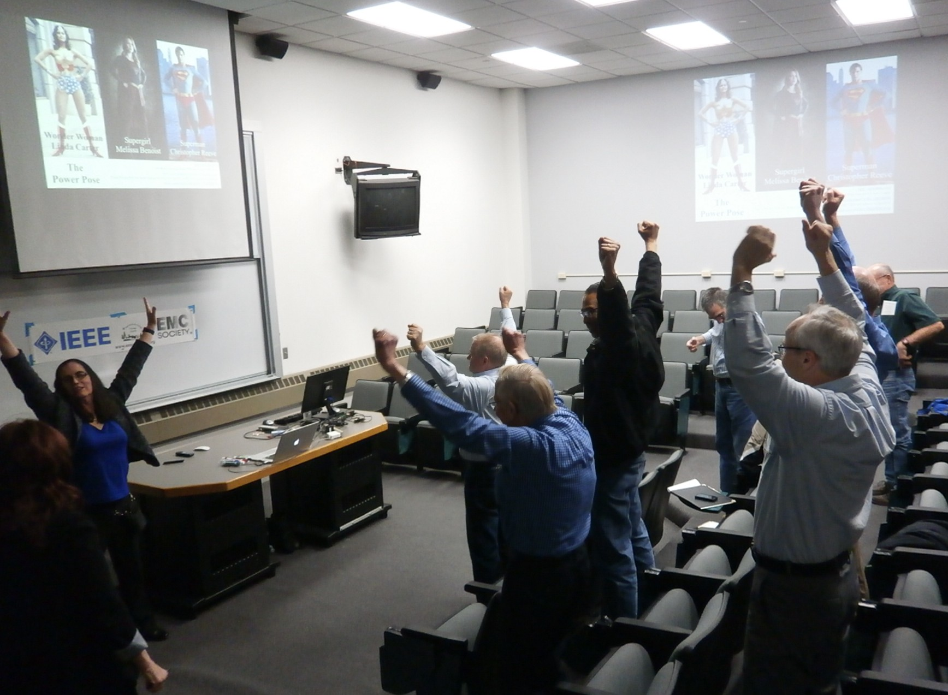
April Chapter Meeting
Joanna Hill Hella Corporation
Achieve by Communication

Slide 13
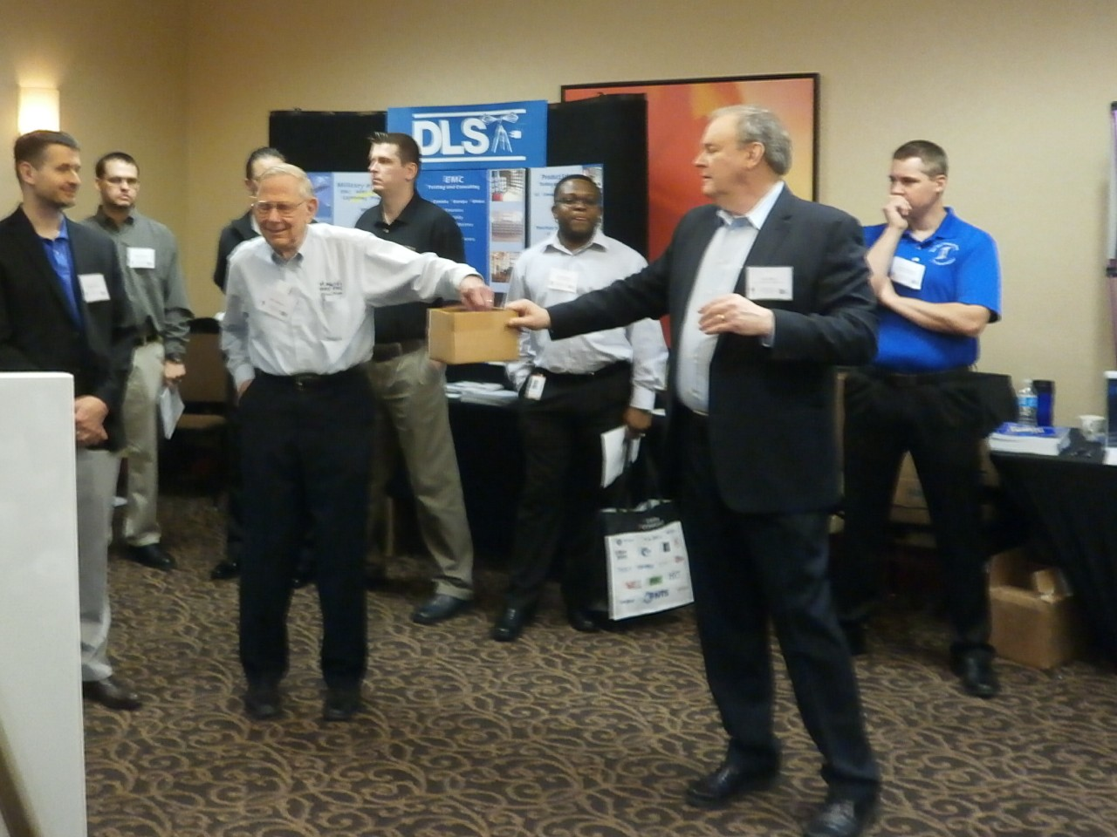
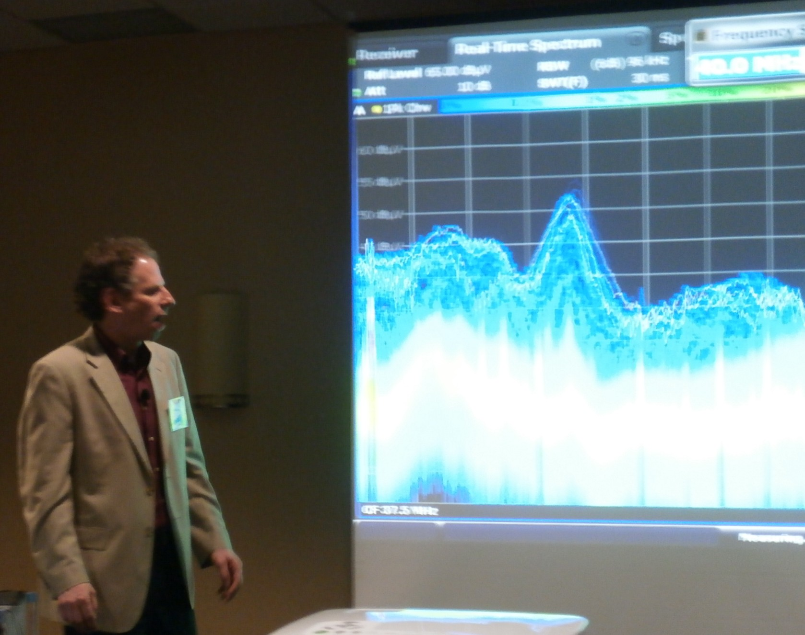
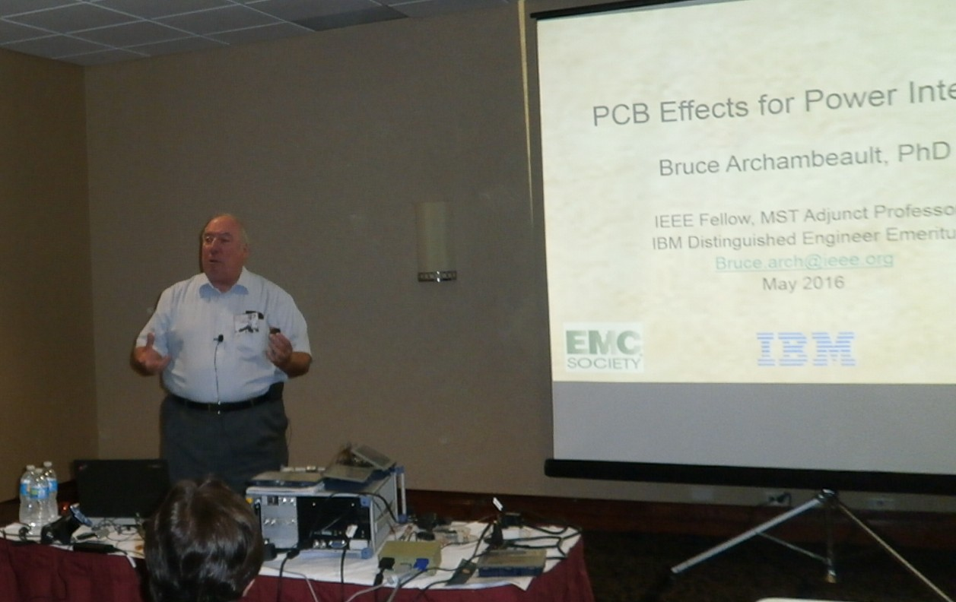
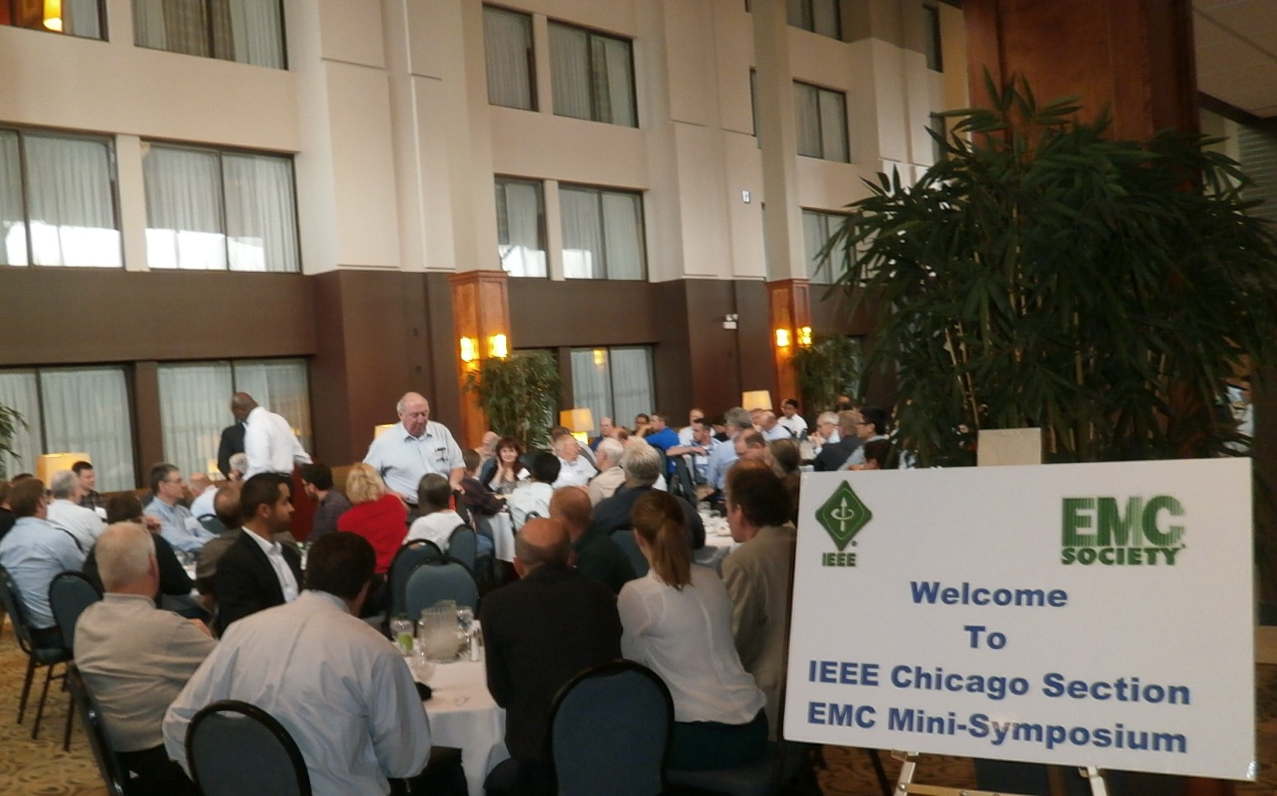
19th Annual EMC Mini Symposium
Bruce –Lee Show
Frank Krozel-Mini Symposium Chair
146 Attendees
20 Vendors

Slide 14
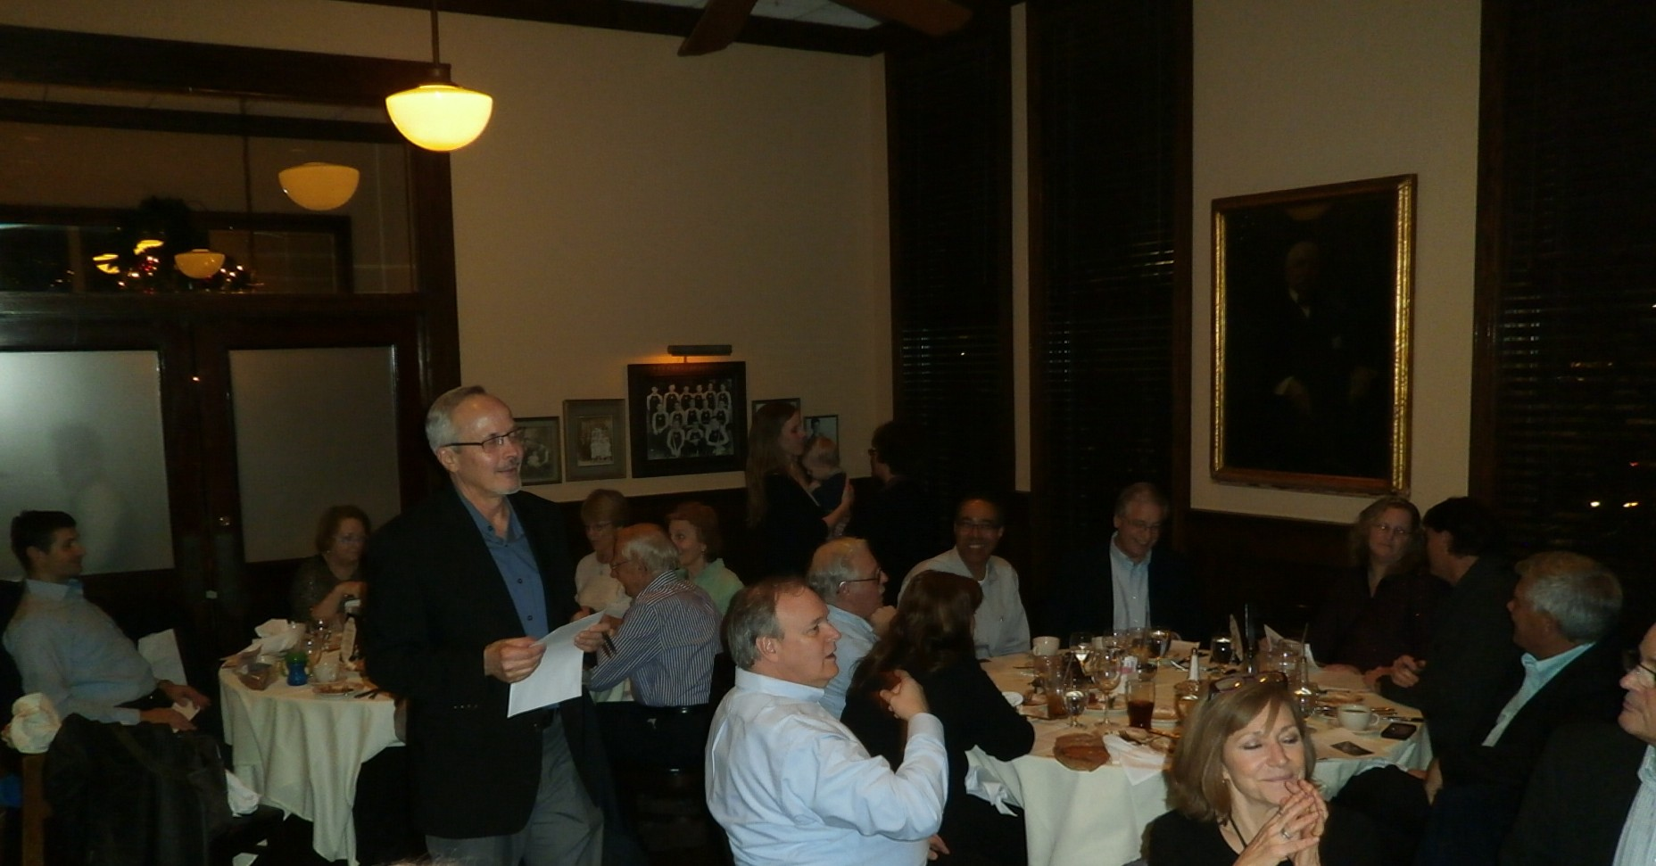
Award Banquet
Bob Hofmann Person of the Year

